Slide 1
Forum on Eversource’s “Resiliency Project” Woodstock Conservation Commission November 30, 2022

Slide 2
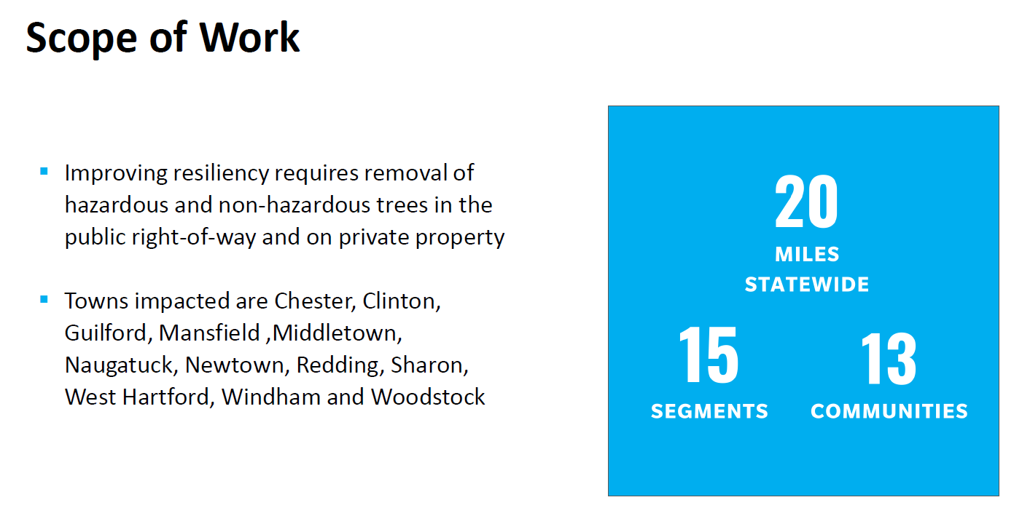
WCC Meeting With Eversource August 22, 2022
Source: Eversource presentation to WCC on August 22, 2022
YOU CAN FIND A RECORDING OF THIS MEETING ON TOWN OF WOODSTOCK WEBSITE

Slide 3
Source: Eversource presentation to WCC on August 22, 2022

Slide 4
Source: Eversource presentation to WCC on August 22, 2022

Slide 5
Work Along Targeted Roads May Include:
Cutting trees along the power line path that are taller than 30 feet
Cutting trees that are expected to grow taller than 30 feet
Cutting trees that are 30+ feet distant from the power lines. This could include trees that are up to 80 feet from the power lines but have the height or lean to meet project criteria
Replacing some of the cut trees with native and non-native shrubs or trees that will not exceed 30 feet in height at maturity.

Slide 6
Targeted Roadways
Source: Slide from Eversource presentation to WCC on August 22, 2022

Slide 7
Somers Tpk/Rt 171
Source: Slide from Eversource presentation to WCC on August 22, 2022

Slide 8
Somers Tpk/Rt 171
Source: Slide from Eversource presentation to WCC on August 22, 2022

Slide 9
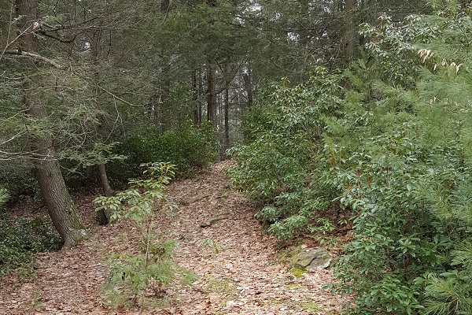
Norwich-Worcester Tpk/Rt. 169
Segment unclear, no map provided by Eversource
Border Woods Preserve, New Roxbury Land Trust, Rt 169

Slide 10
Source: Slide from Eversource presentation to WCC on August 22, 2022

Slide 11
Problems With Eversource’s Consent Procedure
Door tags are easily lost or overlooked
10-day consent window is short, does not account for owners who are away or unavailable due to disability/illness, or who live in town only part of the year
Does not account for land with no physical structure
Eversource’s assumption that property owners are OK with the cutting if no response

Slide 12
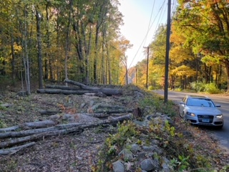
This is Not The “Routine” Vegetation Management That We Are Familiar With
Bethel, CT
Eversource Cutting Fall 2022

Slide 13
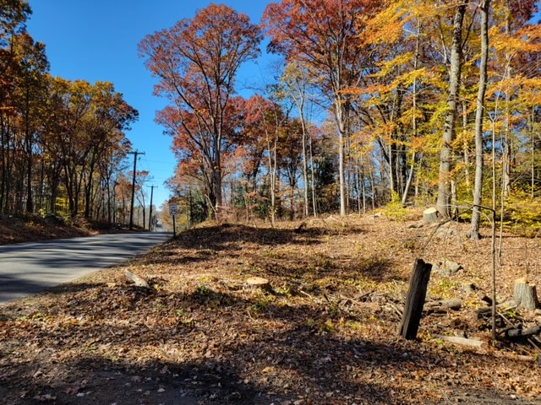
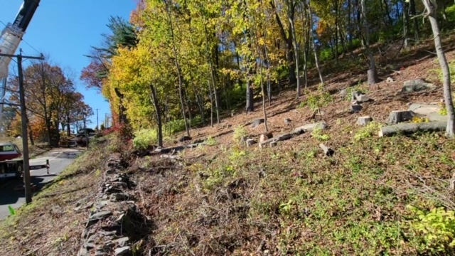
Newtown, CT Eversource Resiliency Project Fall 2022

Slide 14
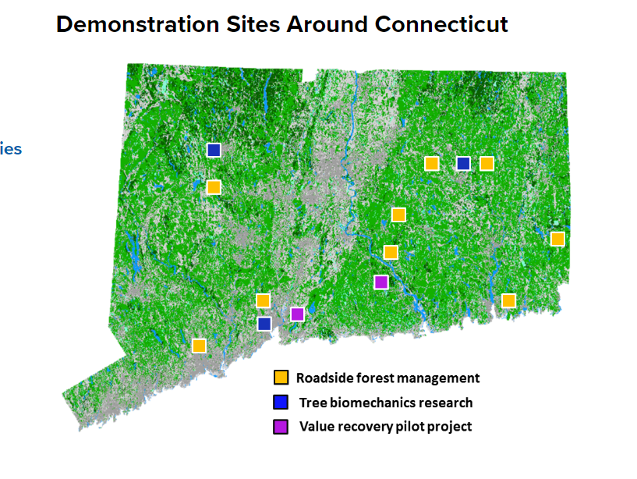
True Resiliency is Not a Quick Fix
Stormwise is a program developed by the University of Connecticut and the CT Agricultural Experiment Station. It is based on an approach to the maintenance of forested roadsides that balances the trees, utilities and people.

Slide 15
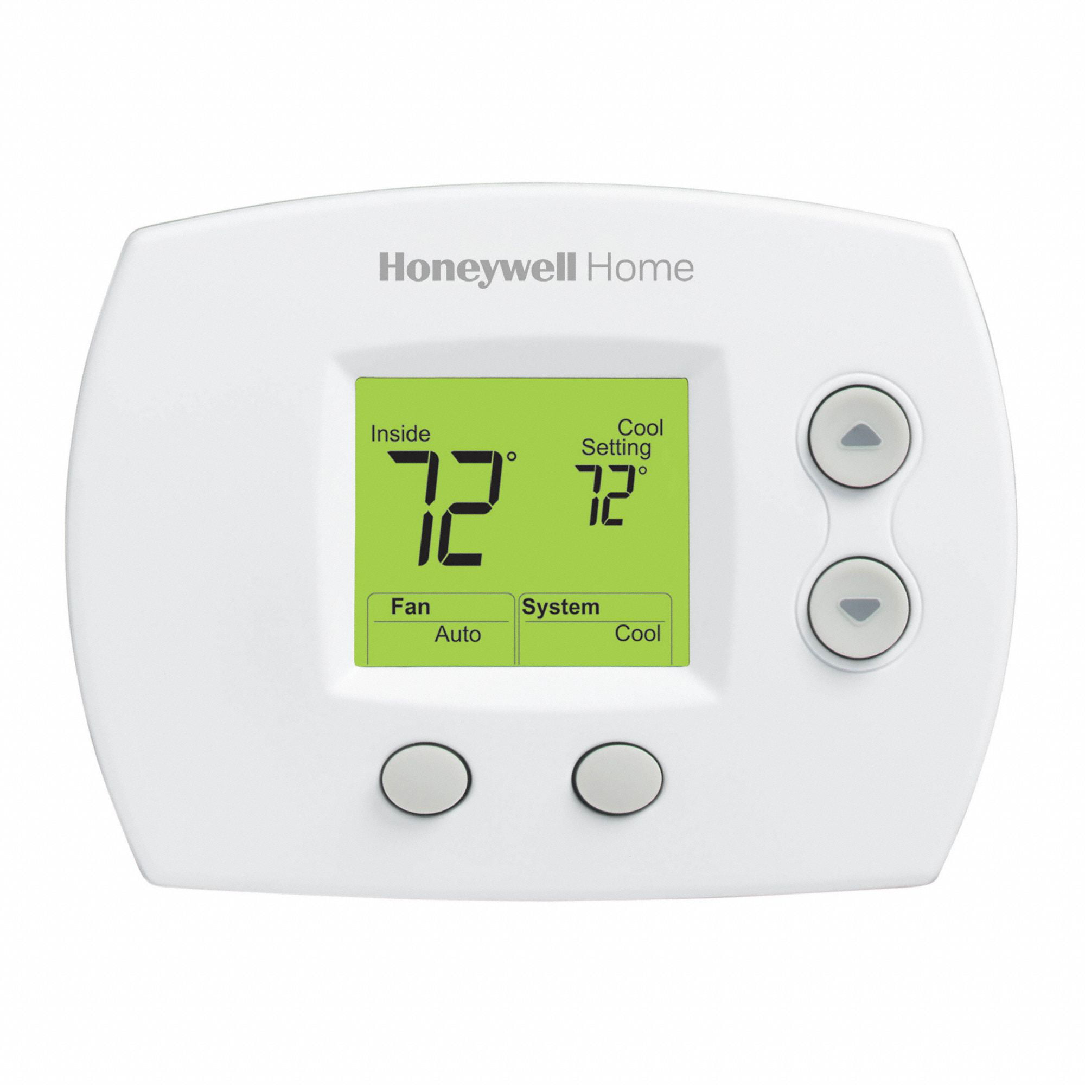
Is It Worth It?
Increase exposure on homes which can increase heating or cooling costs

Slide 16
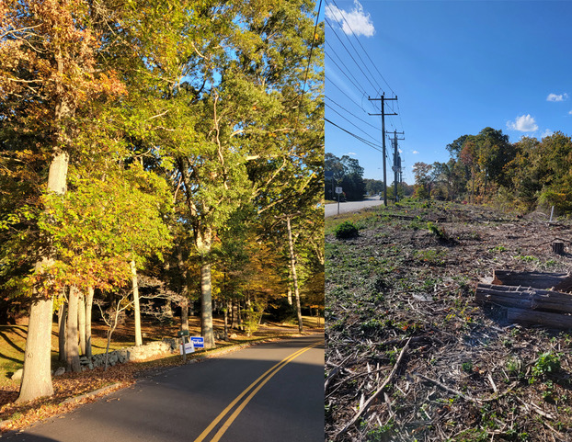
Is It Worth It?
Increase exposure on homes which can increase heating or cooling costs
Loss of scenic character on our roadways, with reduced economic and aesthetic benefits
Madison, CT

Slide 17
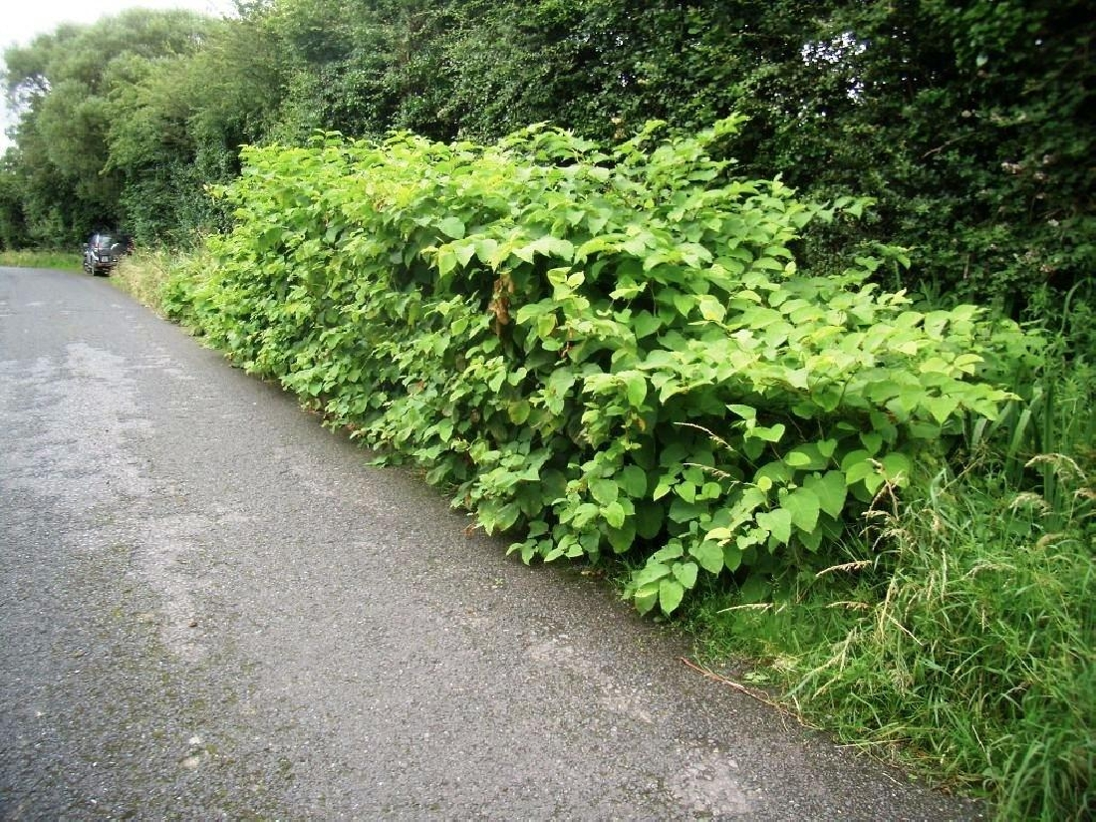
Is It Worth It?
Increase exposure on homes which can increase heating or cooling costs
Loss of scenic character on our roadways – economic and aesthetic value
Increased non-native and invasive plants along our roadways
Japanese knotweed taking over the roadside

Slide 18
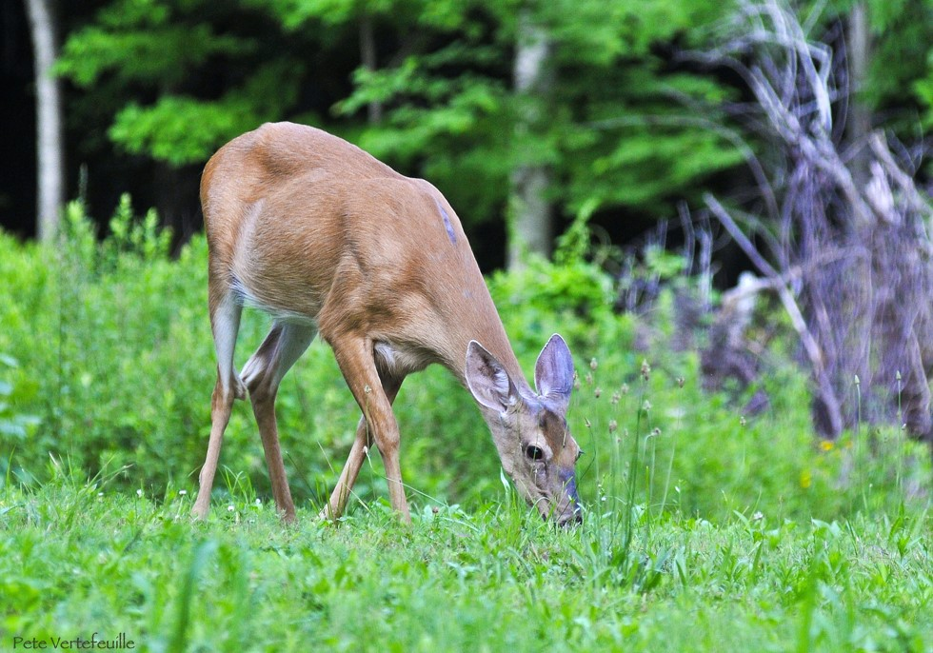
Is It Worth It?
Increase exposure on homes which can increase heating or cooling costs
Loss of scenic character on our roadways – economic and aesthetic value
Increased non-native and invasive plants along our roadways
Change in important wildlife habitat

Slide 19
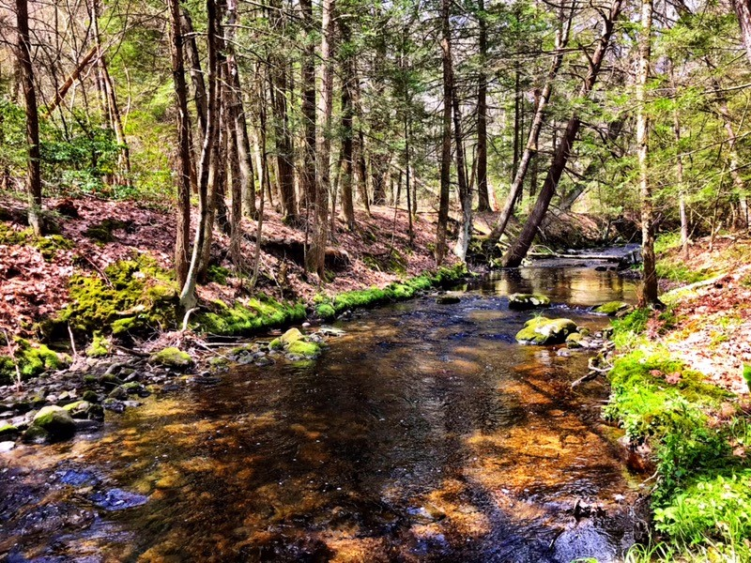
Is It Worth It?
Increase exposure on homes which can increase heating or cooling costs
Loss of scenic character on our roadways – economic and aesthetic value
Increased non-native and invasive plants along our roadways
Loss of important wildlife habitat
Threats to watershed health

Slide 20
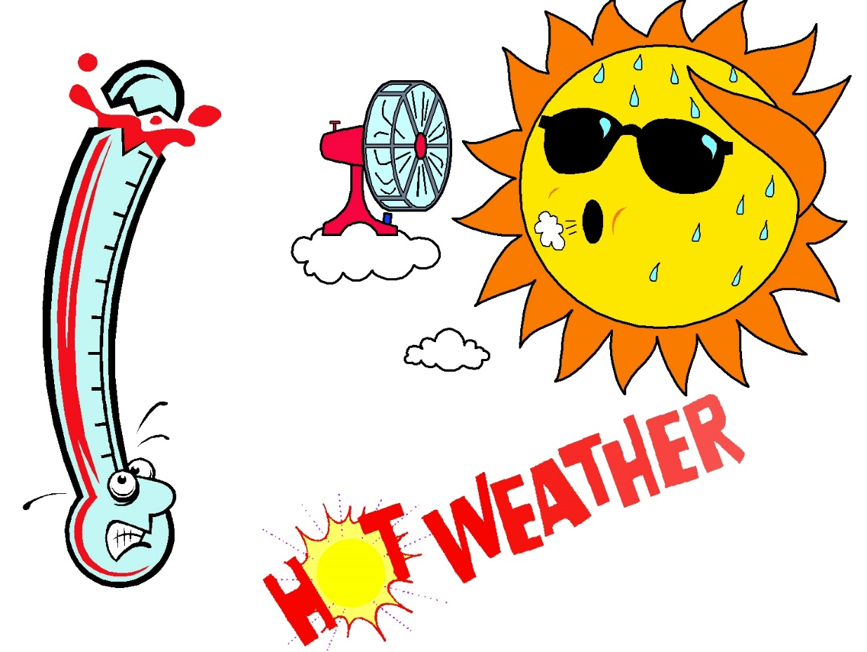
Is It Worth It?
Increase exposure on homes which can increase heating or cooling costs
Loss of scenic character on our roadways – economic and aesthetic value loss
Increased non-native and invasive plants along our roadways
Loss of important wildlife habitat
Threats to watershed health
Reduce our town’s climate resiliency

Slide 21
Eversource Wants to Replace Some Trees

Slide 22
More Work For Property Owners
Eversource will only plant new trees. The watering, weeding, and care for planted trees is the responsibility of the property owners.
Replanting sites in other towns are seeing invasive plants overtake planted saplings quickly in places where there is a lack of people to maintain the area.

Slide 23
Timeline?
Source: Slide from Eversource presentation to WCC on August 22, 2022

Slide 24
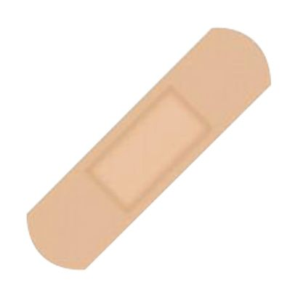
This Is A Very Costly Band-Aid Meant To Fix A Larger Problem
This does not address the 40% of power outages that are not caused by trees
This is not a truly resilient project and is likely to become a state-wide “fix”
This is a short-term solution for power loss
This is not a truly collaborative effort between our town, environmental professionals, and Eversource
No environmental impact study has been done by Eversource

Slide 25
It is YOUR turn to act:
Clearly respond to Eversource’s notification within 10 days
Insist on meeting with the “Eversource Arborist” to determine and flag exactly which trees will be cut (even if you say “No”)
Contact town selectmen, your representatives
Spread the word to your neighbors
Attend a WCC meeting and let us know how this project is affecting your property

Slide 26
Thank You! www.woodstockconservation.org

