Slide 1
Woodstock Affordable Housing Plan public Information Meeting: February 3, 2022
Prepared by Delia Fey, AICP, Senior Regional Planner, NECCOG

Slide 2
Woodstock Zoning 101
Residential Uses in Woodstock Summarized
Zoning |  | Zoning |  | Subdivision | Subdivision
Community District | Lot of record & approved lots pre-8/25/05 | Subdivision lots podt-8/25/05 |  | Minor (1-3 lots) |  | Major (4+ lots)
 | Single family home, (may add accessory apartment) ZP required | Single family home, (may add accessory apartment) ZP required | Multi-family Residential (2+ units) SP required |  | Family Transfer | Standard Design | Conservation Design
 | * 2.5 ac min. * 1 ac contiguous buildable * 100 ft frontage (25’ interior lot)* | *0.75 ac min. lot size & contiguous buildable area *100 ft frontage (25’ interior lot)* | *10 ac min. *Max. density: 1 dwelling per acre of contiguous buildable area *150 ft frontage | *1.25 ac of buildable land *No conservation land required | *5-lot Max *Lots may only be transferred to qualifying family members within 10 years of approval. *No conservation land required. | *Density factor: 2.5 ac *Each lot min. 1.25 ac buildable land *25% Conservation Land required Alternative: Fee in-lieu option | *Density factor: 1.25 ac *Each lot min. 1.0 ac buildable land *40% Conservation Land required
Lake District | *2.5 ac min.
Please refer to the applicable regulations for more details.

Slide 3
Woodstock Zoning 101
What’s missing?
Residential Uses in Woodstock Summarized
Zoning |  | Zoning |  | Subdivision | Subdivision
Community District | Lot of record & approved lots pre-8/25/05 | Subdivision lots podt-8/25/05 |  | Minor (1-3 lots) |  | Major (4+ lots)
 | Single family home, (may add accessory apartment) ZP required | Single family home, (may add accessory apartment) ZP required | Multi-family Residential (2+ units) SP required |  | Family Transfer | Standard Design | Conservation Design
 | * 2.5 ac min. * 1 ac contiguous buildable * 100 ft frontage (25’ interior lot)* | *0.75 ac min. lot size & contiguous buildable area *100 ft frontage (25’ interior lot)* | *10 ac min. *Max. density: 1 dwelling per acre of contiguous buildable area *150 ft frontage | *1.25 ac of buildable land *No conservation land required | *5-lot Max *Lots may only be transferred to qualifying family members within 10 years of approval. *No conservation land required. | *Density factor: 2.5 ac *Each lot min. 1.25 ac buildable land *25% Conservation Land required Alternative: Fee in-lieu option | *Density factor: 1.25 ac *Each lot min. 1.0 ac buildable land *40% Conservation Land required
Lake District | *2.5 ac min.
Please refer to the applicable regulations for more details.
Where are the opportunities for compatible housing?

Slide 4
Woodstock Zoning 101
The way things are today
Comments:
What kind of housing is allowed with a Zoning Permit?
1 Single Family (with accessory buildings)
Accessory apartments are allowed with a Single-Family Home
What kind of housing is allowed with a Special Permit?
Multi-family (2+ units) requires a Special Permit
Works well.
Apartments are put in by property owners that want them.
This has resulted in only 1 application for multi-family use, but it did not include rental units.
It will be interesting to see the results of the survey re: need for affordable housing that would otherwise fit into the categories of accessory apartments and multi-family units.

Slide 5
The full spectrum of housing…
…across America.
Source: www.missingmiddlehousing.com

Slide 6
What could be compatible in Woodstock?
Source: www.missingmiddlehousing.com
*NOTE: For the sake of the image, these units were crammed together but they wouldn’t be built that close together.

Slide 7
What could be compatible in Woodstock?
How about these?
What about these?
We know these fit
Source: www.missingmiddlehousing.com

Slide 8
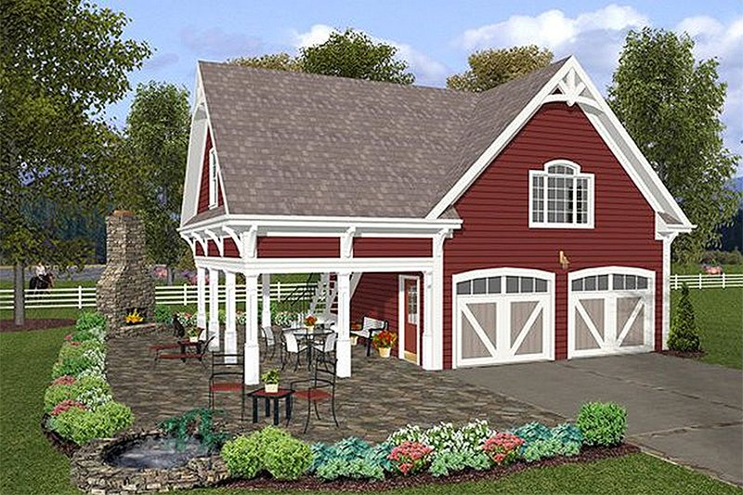
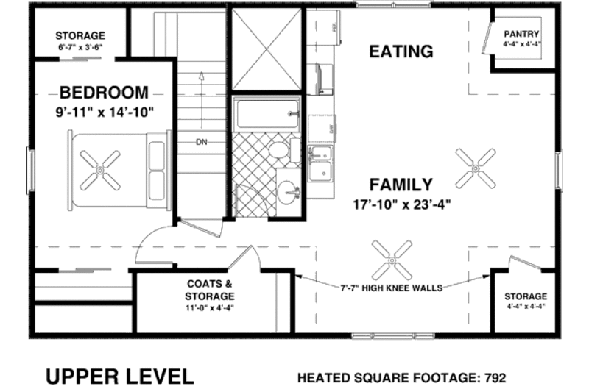
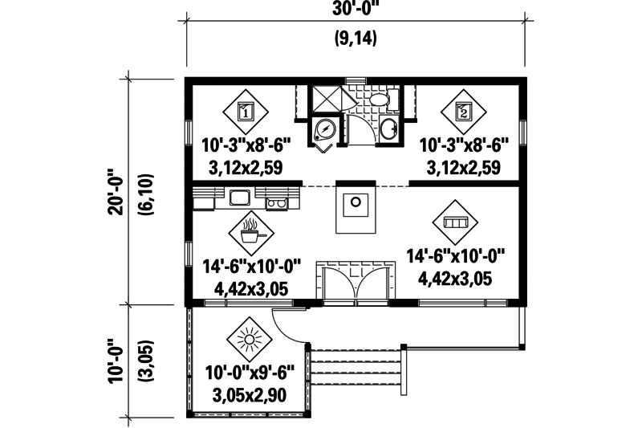
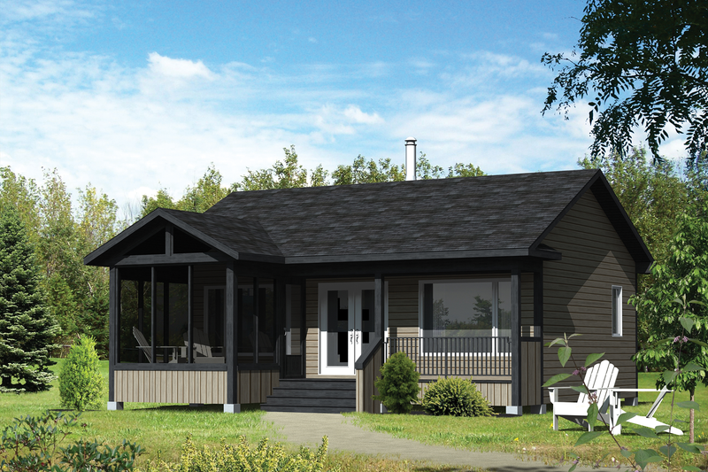
What might accessory apartments look like?
Source: City of Calabasas, CA
Source: www.houseplans.com

Slide 9
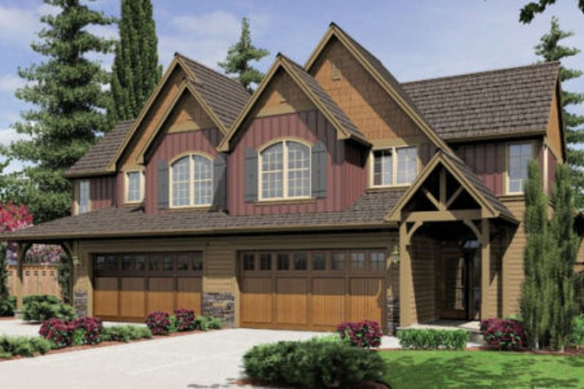
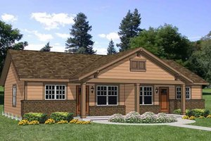
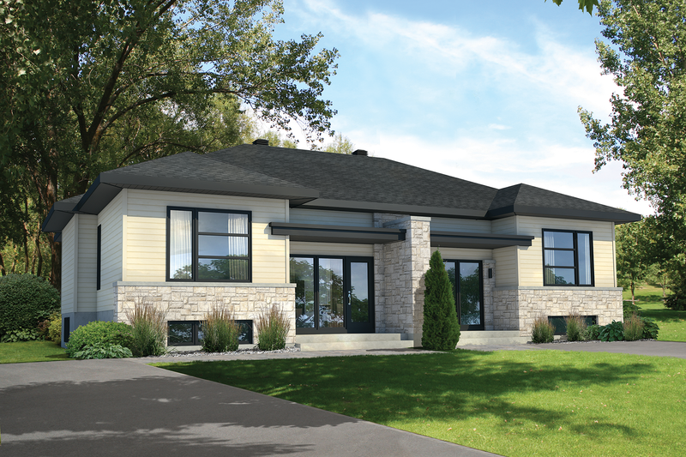
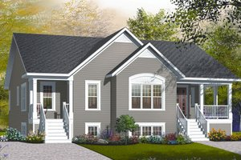
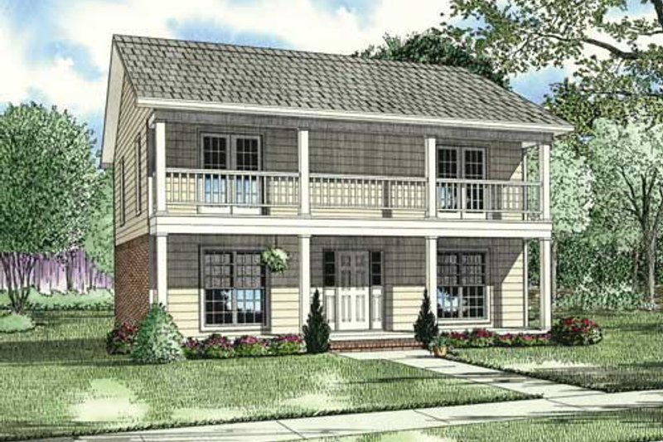
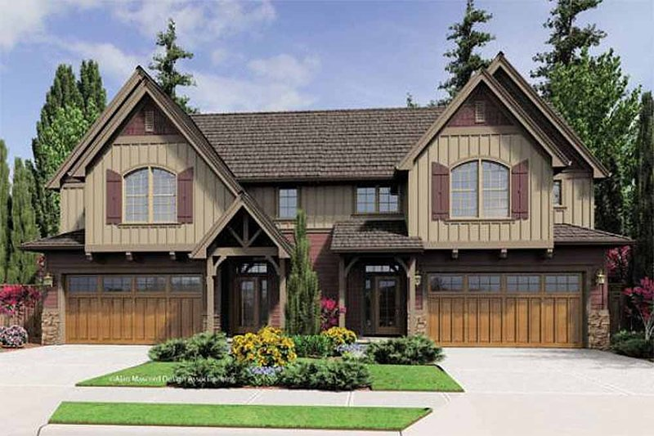
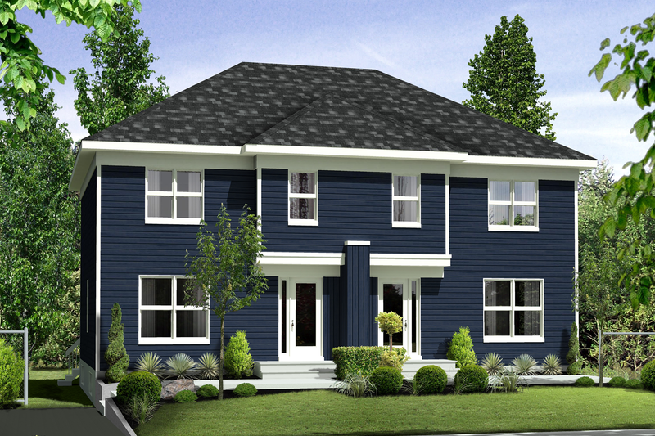
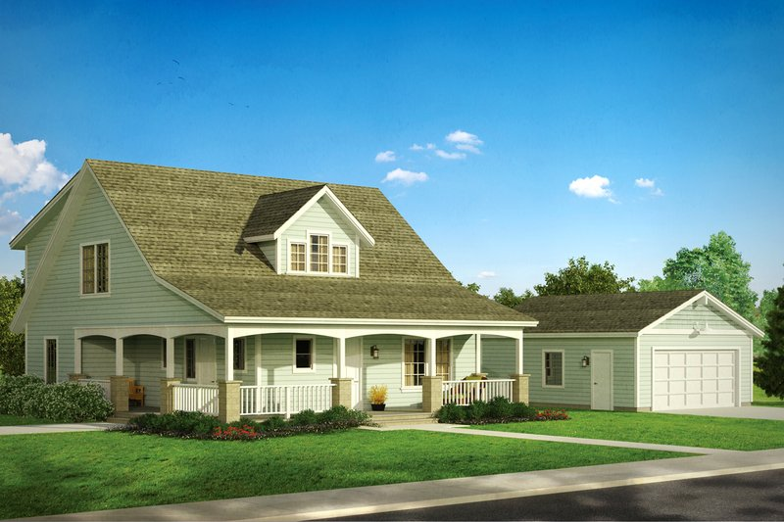
What might duplexes look like?
Source: www.houseplans.com

Slide 10
A few things to keep in mind:
Zoning doesn’t dictate the architecture. The photos were provided for conversation’s sake.
In terms of who might live in the new more attainable homes, think of:
Your adult children in their first home as an independent adult
Your parents as they become empty-nesters
Other relatives
Single parents
Someone who wants to downsize
Your friends or neighbors who fit into one of these categories.
An employee working at a local business.
You, if you fit into one of these categories!

Slide 11
Potential Housing Opportunities Compatible in Rural Communities
Duplexes – can be done with little additional impact on the environment or the community compared to single family homes.
Especially with conversion of existing single-family homes to duplexes.
Condominiums or Townhouses
Additional Senior Housing
Independent & Assisted Senior Living
Mixed-Use Zoning to allow residential and business on the same lot (above business or elsewhere on the lot)
Multi-family rental housing

Slide 12
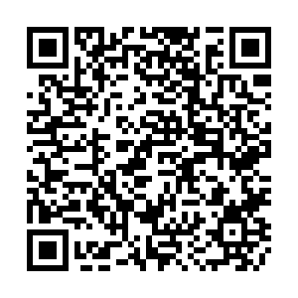
I have an interactive live survey for you.
Let’s do one question at a time.
To take the survey: click on the link in the chat, use QR code or type in on your internet browser (on your desktop, laptop or phone) the following website:
PollEv.com/maureenadams304

Slide 13
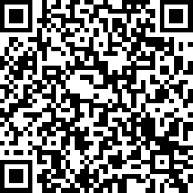
If you haven’t done the Woodstock Housing Survey…
The survey is available on your phone with the QR code or online at: https://www.surveymonkey.com/r/88F3VF2
Paper surveys are available for download from the town website here:
https://www.woodstockct.gov/home/news/affordable-housing-survey
and at the libraries, Town Hall & Sweet Evalina’s.
So far we have had 355 survey responses!
This is AMAZING but we can do EVEN better!

Slide 14
For more information, please contact:
Delia P. Fey, AICP
Senior Regional Planner
Northeastern Connecticut Council of Governments
860-774-1253 x20
delia.fey@neccog.org

